Slide 1
IP Addressing

Slide 2
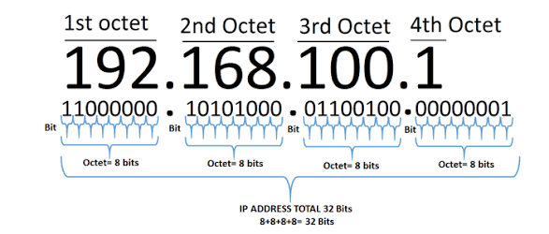
What is IP address?
IP address is a 32 bit sequence of 0s and 1s
A way to identify machine on a network
A unique identifier
A numerical label

Slide 3
IP Usage
Used to connect to another computer
Allow transfer of files or exchange of information

Slide 4
Services provided by IP
Addressing
Fragmentation

Slide 5
IP Terminology
Several Important terms to understand IP
BIT :- A bit is one digit; either a 1 or a 0
BYTE :- A byte is 7 or 8 bits, depending on whether parity, always assume a byte is 8 bits
OCTET:- An octet, made up of 8 bits

Slide 6
IP Structure
IP address consist of four sections
Each section is 8bits long
Each section can range from 0 to 255
Example 192.168.1.18

Slide 7
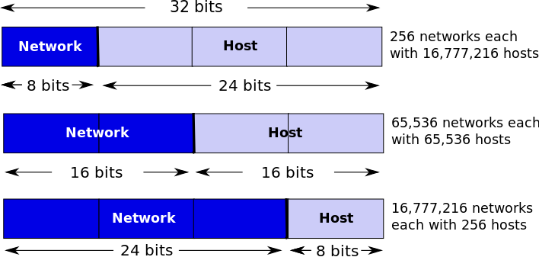
Parts of IP Address
Network part
Host part

Slide 8
Parts of IP Address
8 bits | 8 bits | 8 bits | 8 bits
Class A :
Network | Host | Host | Host
Class B :
Network | Network | Host | Host
Class C :
Network | Network | Network | Host
Class D :
Multicast
Class E :
Research

Slide 9
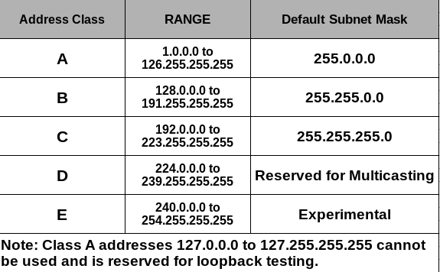
IP Classes
Class A
Class B
Class C
Class D
Class E

Slide 10
Private and Public IP address
Private – A range of IP address reserved for local area network; it is free
Public – To connect or travel in internet we need public IP address; it is chargeable
*To find public ip address of your system or mobile type the following URL: https://www.ipchicken.com/

Slide 11
Private IP Address
Address class | Reserved address space
Class A | 10.0.0.0 through 10.255.255.255
Class B | 172.16.0.0 through 172.31.255.255
Class C | 192.168.0.0 through 192.168.255.255

Slide 12
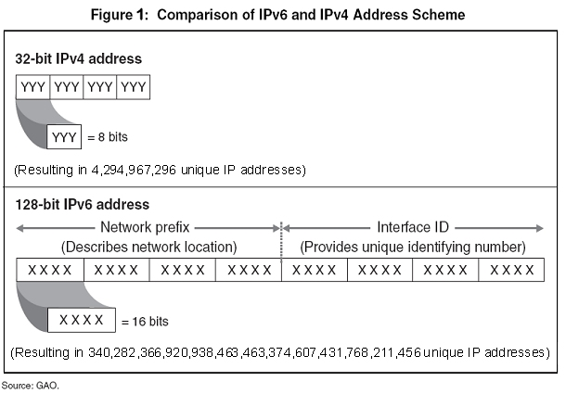
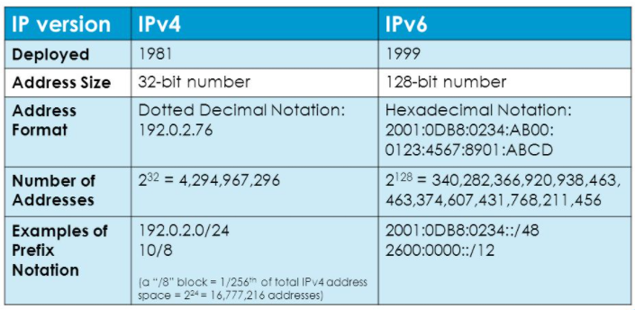
IP Versions

Slide 13
Allocation of IP address
Static Address (Assigning IP address manually)
Dynamic Address (Server will assign IP address automatically to hosts using DHCP / BOOTP protocols)

Slide 14
IP Commands
Windows:
ipconfig or ipconfig /all (to find the ip address assigned to your system)
Unix / Linux:
Ifconfig (to find the ip address assigned to your system)

Slide 15
Network Masks
Distinguishes which portion of the address identifies the network and which portion of the address identifies the node.
Default masks:
Class A: 255.0.0.0
Class B: 255.255.0.0
Class C: 255.255.255.0

Slide 16
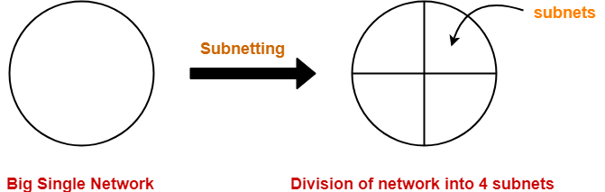
Subnetting
The process of dividing a single network into multiple sub networks is called as subnetting.
The sub networks so created are called as subnets.

Slide 17
Subnetting
Creates multiple logical networks that exist within a single Class A, B, or C network.
If you do not subnet, you will only be able to use one network from your Class A, B, or C network, which is unrealistic
Each data link on a network must have a unique network ID, with every node on that link being a member of the same network

Slide 18
Benefits of Subnetting
Reduced network traffic
Optimized network performance
Simplified management
Facilitated spanning of large geographical distances

Slide 19
How to create subnets
Determine the number of required network IDs:
One for each subnet
One for each wide area network connection
Determine the number of required host IDs per subnet:
One for each TCP/IP host
One for each router interface
Based on the above requirements, create the following:
One subnet mask for your entire network
A unique subnet ID for each physical segment
A range of host IDs for each subnet

Slide 20
Subnetting a Class A/B/C Address
How many subnets does the chosen subnet mask produce?
How many valid hosts per subnet are available?
What are the valid subnets?
What’s the broadcast address of each subnet?
What are the valid hosts in each subnet?

Slide 21
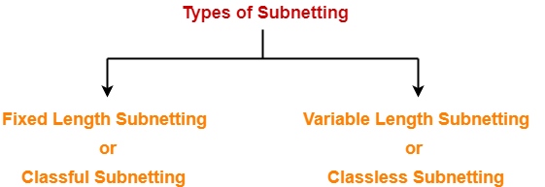
Subnetting types
Fixed Length
All the subnets are of same size.
All the subnets have equal number of hosts.
All the subnets have same subnet mask.
Variable Length Subnet Mask
All the subnets are not of same size.
All the subnets do not have equal number of hosts.
All the subnets do not have same subnet mask.

Slide 22
Problem - 1

Slide 23
Fixed Length subnet masking
Consider an address block 121.37.10.64 /26.
Find the first and last addresses for each subnet, if the number of equal sized subnets required is as given in the input.
Number of subnets required = 4
Result:
Subnet-1:
First Address: 121.37.10.64 /28
Last Address: 121.37.10.79 /28
Subnet-2:
First Address: 121.37.10.80 /28
Last Address: 121.37.10.95 /28
Subnet-3:
First Address: 121.37.10.96 /28
Last Address: 121.37.10.111 /28
Subnet-4:
First Address: 121.37.10.112 /28
Last Address: 121.37.10.127 /28

Slide 24
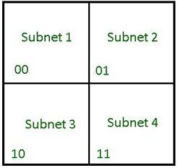
Fixed Length subnet masking – continued…
Since 4 subnets are required, we need 2 bits to identify each subnet. Thus the subnet mask now becomes (/28)..
Number of variable bits left = 32 -28 = 4 bits. Thus the total number of addresses in each subnet= 2⁴= 16.
Address space divided into 4 equal sized subnets

Slide 25
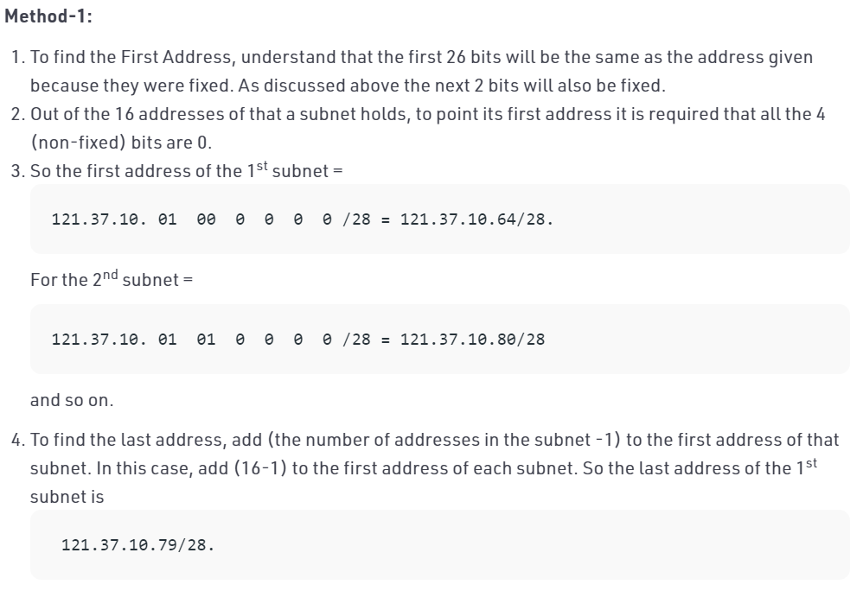
Fixed Length subnet masking – continued…

Slide 26
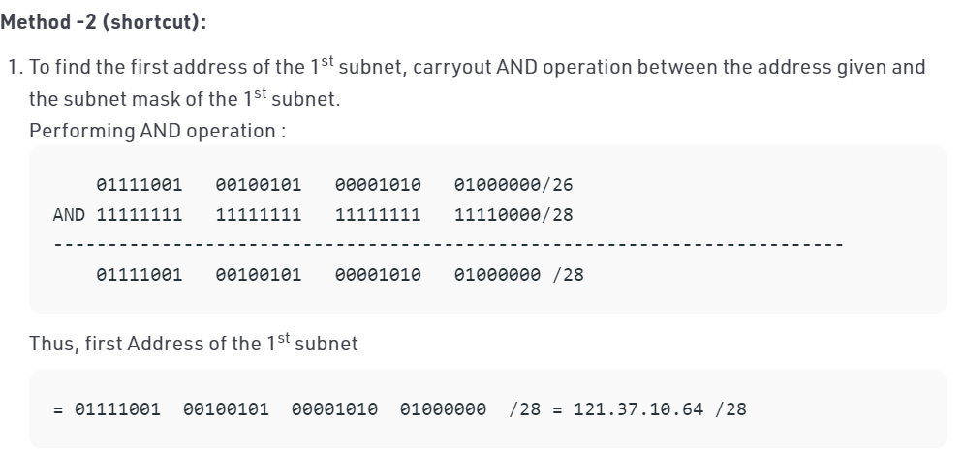
Fixed Length subnet masking – continued…

Slide 27
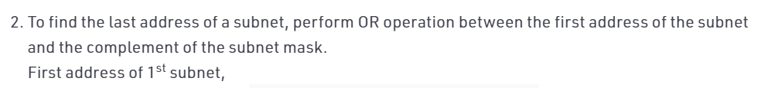
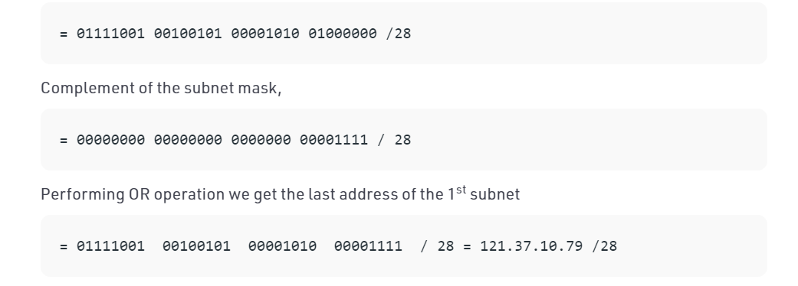
Fixed Length subnet masking – continued…

Slide 28
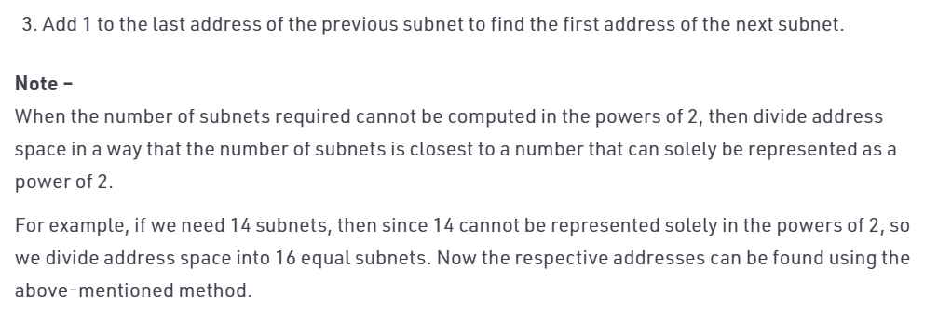
Fixed Length subnet masking – continued…

Slide 29
Problem – 2

Slide 30
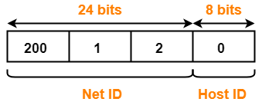
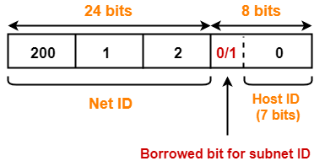
Problem#2
We have a big single network having IP Address 200.1.2.0.
We want to do subnetting and divide this network into 2 subnets.
Solution:
Clearly, the given network belongs to class C.
For creating two subnets and to represent their subnet IDs, we require 1 bit. So,
We borrow one bit from the Host ID part.
After borrowing one bit, Host ID part remains with only 7 bits.
If borrowed bit = 0, then it represents the first subnet.
If borrowed bit = 1, then it represents the second subnet

Slide 31
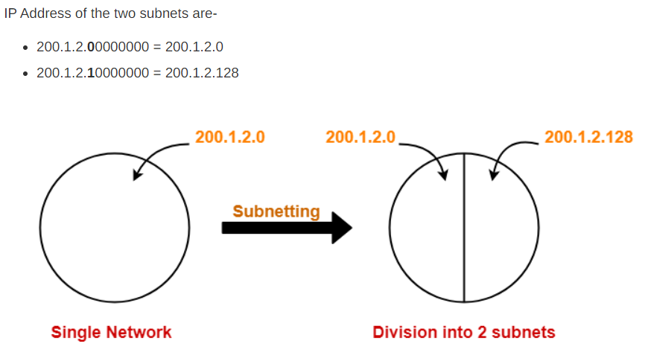
Problem#2

Slide 32
Problem#2
For 1st Subnet-
IP Address of the subnet = 200.1.2.0
Total number of IP Addresses = 2⁷ = 128
Total number of hosts that can be configured = 128 – 2 = 126
Range of IP Addresses = [200.1.2.00000000, 200.1.2.01111111] = [200.1.2.0, 200.1.2.127]
Direct Broadcast Address = 200.1.2.01111111 = 200.1.2.127
Limited Broadcast Address = 255.255.255.255
For 2nd Subnet-
IP Address of the subnet = 200.1.2.128
Total number of IP Addresses = 2⁷ = 128
Total number of hosts that can be configured = 128 – 2 = 126
Range of IP Addresses = [200.1.2.10000000, 200.1.2.11111111] = [200.1.2.128, 200.1.2.255]
Direct Broadcast Address = 200.1.2.11111111 = 200.1.2.255
Limited Broadcast Address = 255.255.255.255

Slide 33
Problem - 3

Slide 34
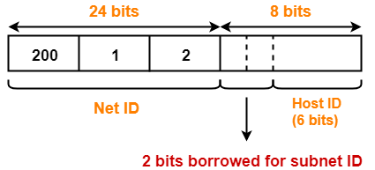
Problem - 3
We have a big single network having IP Address 200.1.2.0.
We want to do subnetting and divide this network into 4 subnets.
Clearly, the given network belongs to class C.
For creating four subnets and to represent their subnet IDs, we require 2 bits. So,
We borrow two bits from the Host ID part.
After borrowing two bits, Host ID part remains with only 6 bits.
If borrowed bits = 00, then it represents the 1st subnet.
If borrowed bits = 01, then it represents the 2nd subnet.
If borrowed bits = 10, then it represents the 3rd subnet.
If borrowed bits = 11, then it represents the 4th subnet.

Slide 35
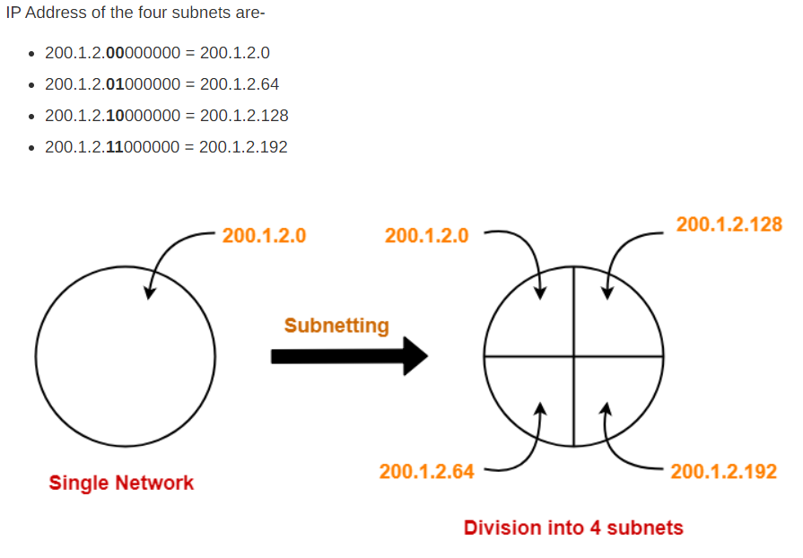
Problem#3

Slide 36
Problem#3
For 1st Subnet-
IP Address of the subnet = 200.1.2.0
Total number of IP Addresses = 2⁶ = 64
Total number of hosts that can be configured = 64 – 2 = 62
Range of IP Addresses = [200.1.2.00000000, 200.1.2.00111111] = [200.1.2.0, 200.1.2.63]
Direct Broadcast Address = 200.1.2.00111111 = 200.1.2.63
Limited Broadcast Address = 255.255.255.255
For 2nd Subnet-
IP Address of the subnet = 200.1.2.64
Total number of IP Addresses = 2⁶ = 64
Total number of hosts that can be configured = 64 – 2 = 62
Range of IP Addresses = [200.1.2.01000000, 200.1.2.01111111] = [200.1.2.64, 200.1.2.127]
Direct Broadcast Address = 200.1.2.01111111 = 200.1.2.127
Limited Broadcast Address = 255.255.255.255

Slide 37
Problem#3
For 3rd Subnet-
IP Address of the subnet = 200.1.2.128
Total number of IP Addresses = 2⁶ = 64
Total number of hosts that can be configured = 64 – 2 = 62
Range of IP Addresses = [200.1.2.10000000, 200.1.2.10111111] = [200.1.2.128, 200.1.2.191]
Direct Broadcast Address = 200.1.2.10111111 = 200.1.2.191
Limited Broadcast Address = 255.255.255.255
For 4th Subnet-
IP Address of the subnet = 200.1.2.192
Total number of IP Addresses = 2⁶ = 64
Total number of hosts that can be configured = 64 – 2 = 62
Range of IP Addresses = [200.1.2.11000000, 200.1.2.11111111] = [200.1.2.192, 200.1.2.255]
Direct Broadcast Address = 200.1.2.11111111 = 200.1.2.255
Limited Broadcast Address = 255.255.255.255

